Slide 1
Low Pass Eccosorb Filter

Slide 2
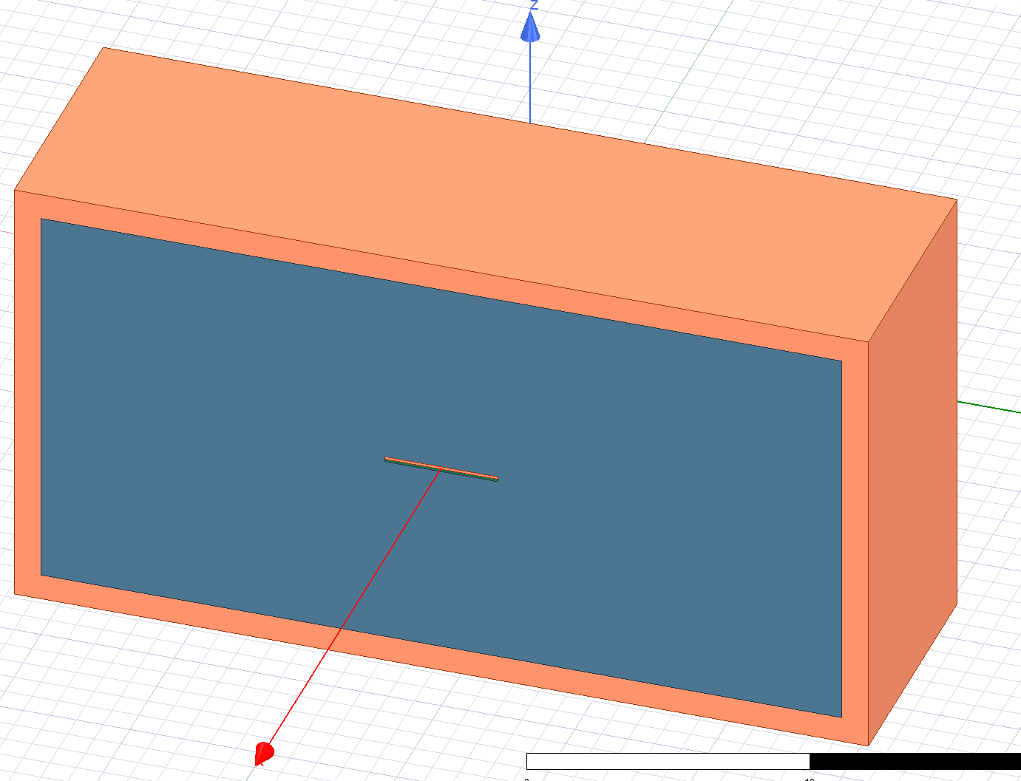
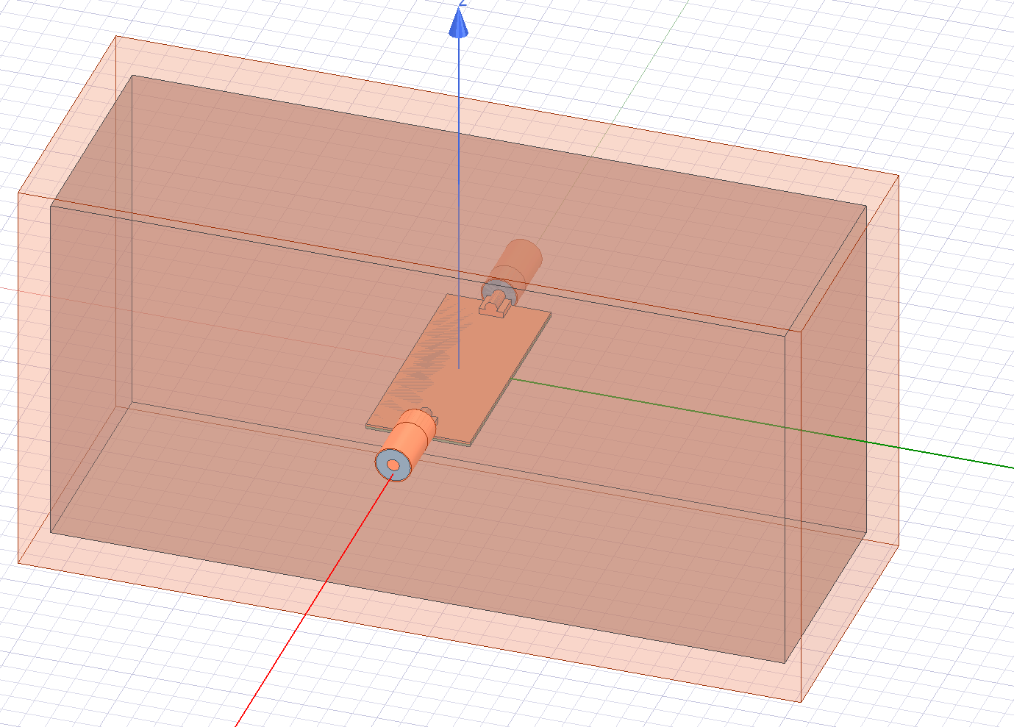
Geometries
Ideal stripline model
Connectorised stripline on FR4-PCB

Slide 3
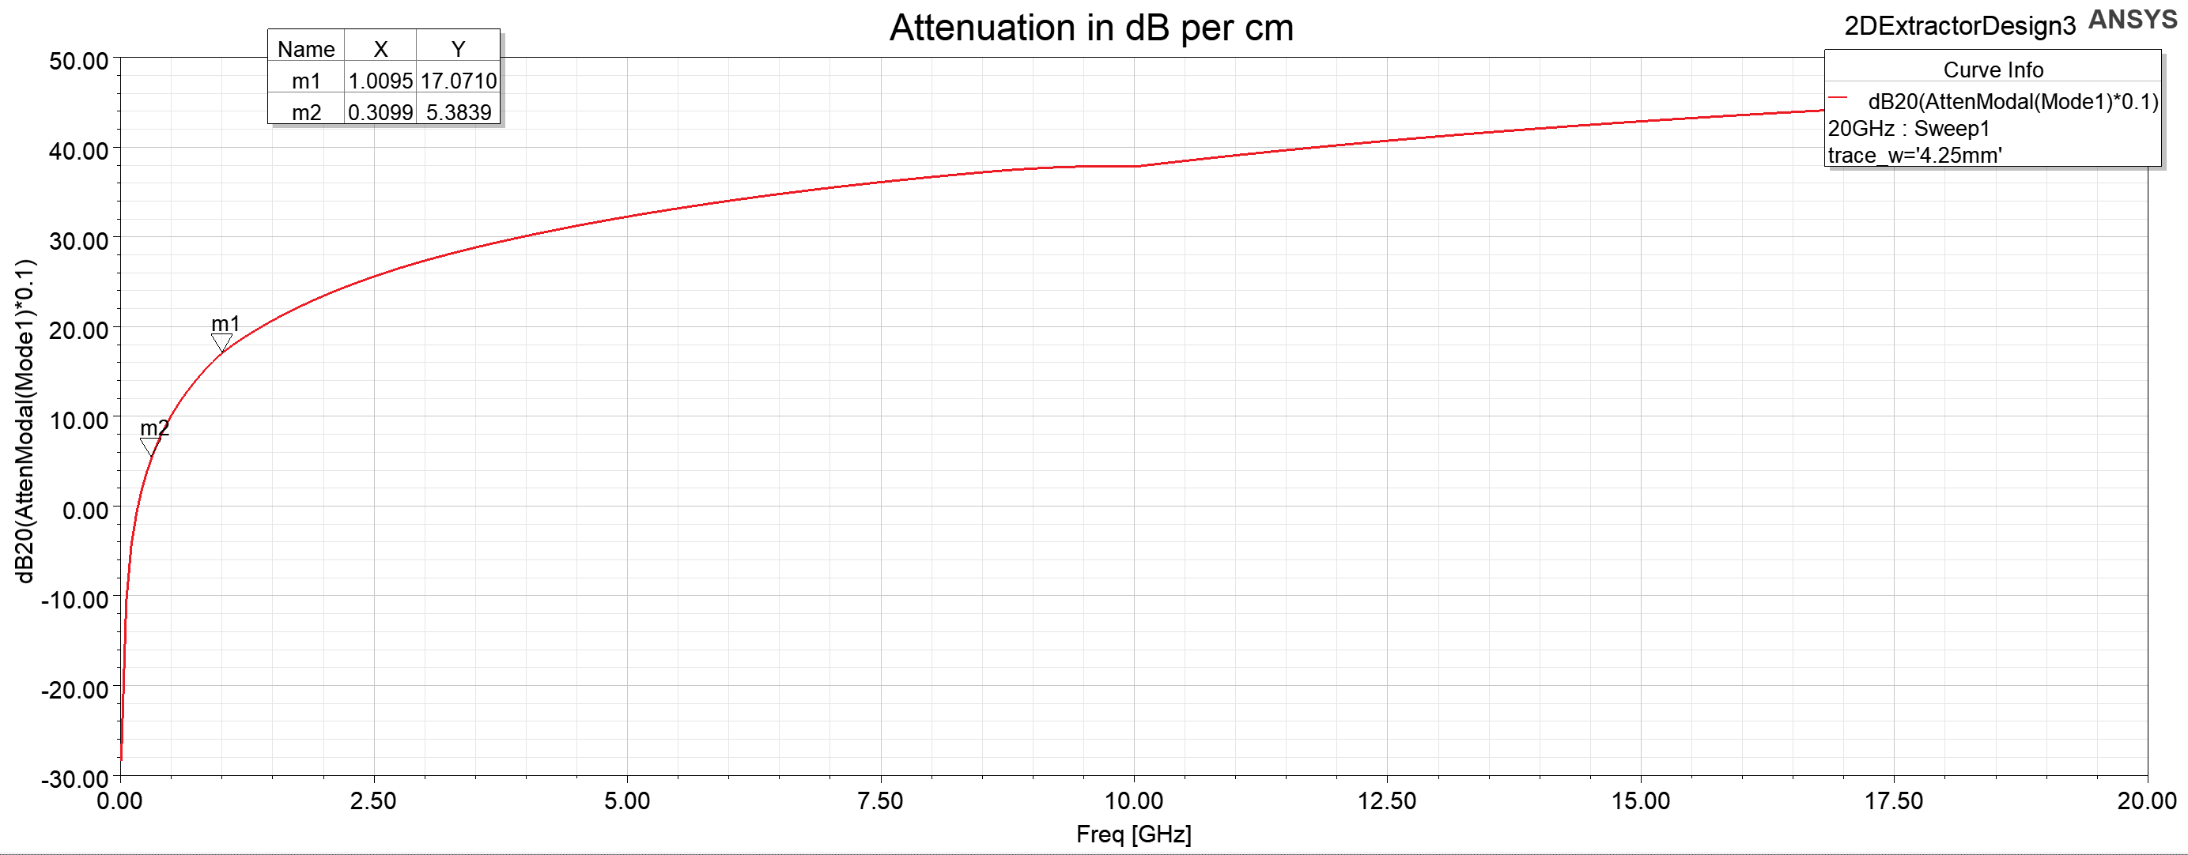
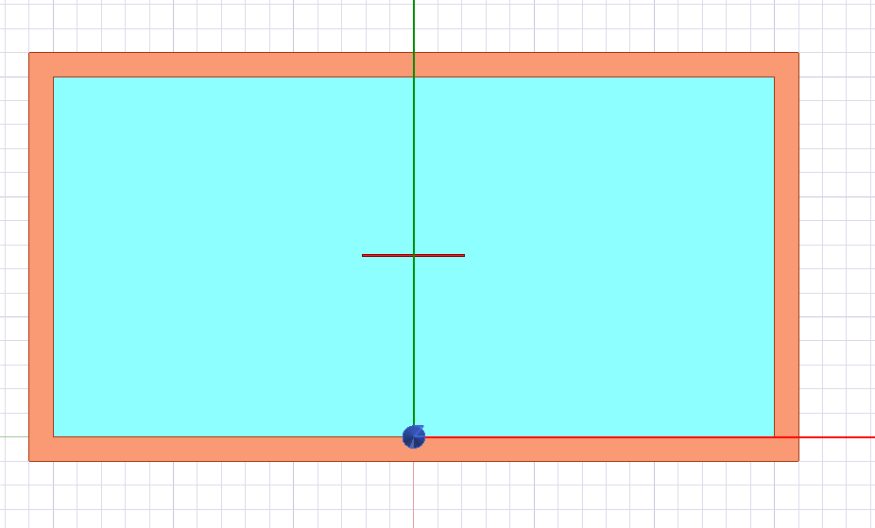
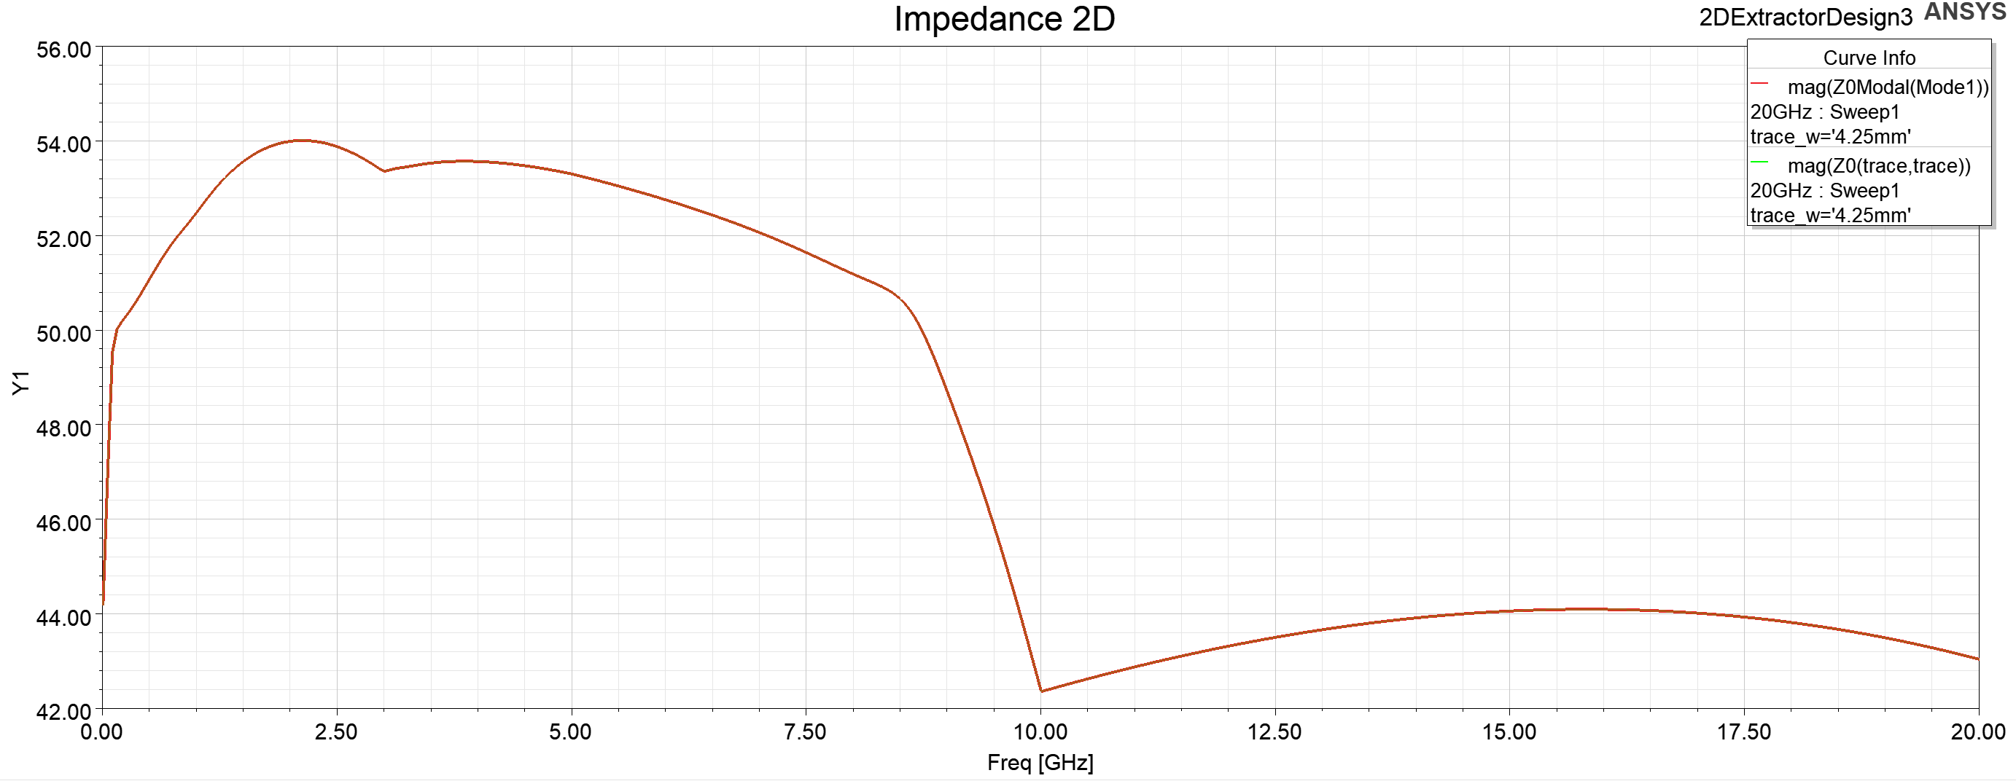
Ideal Stripline 2D
Trace width = 4.25 mm Box height = 15 mm, Box width = 30 mm
2D simulations

Slide 4
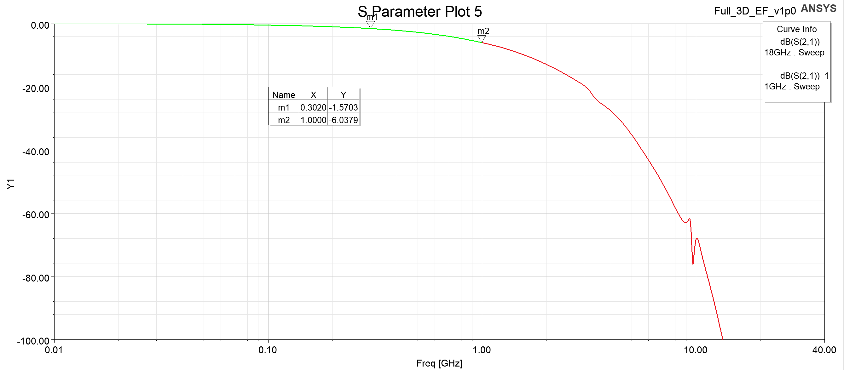
Ideal Stripline 3D

Slide 5
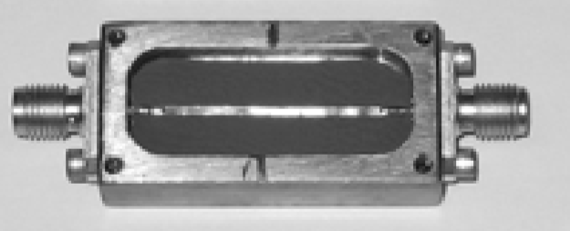
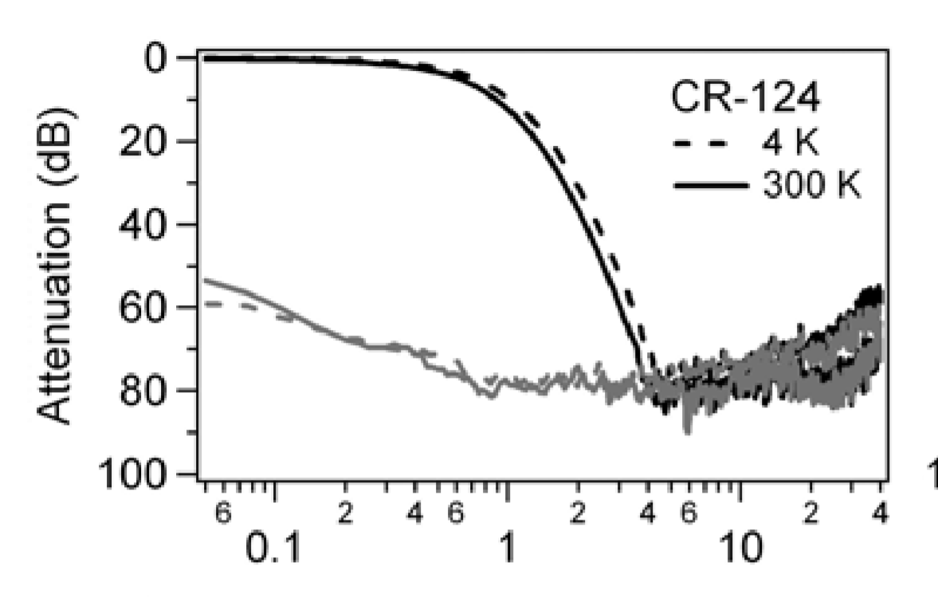
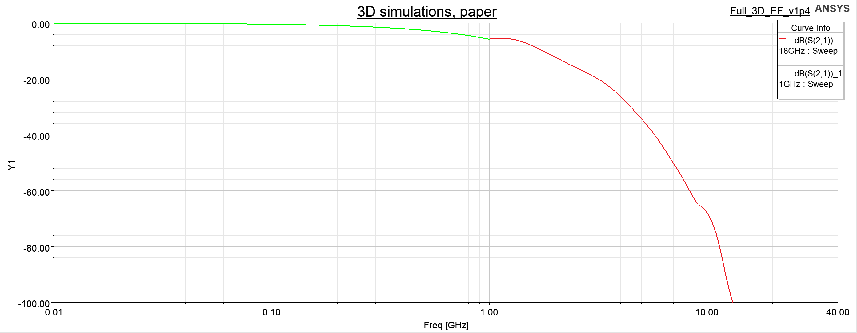
Paper comparison
Impedance-matched low-pass stripline filters by D. F. Santavicca and D. E. Prober
Trace width = 1.4 mm Box height = 4.6 mm, Box width = 18 mm

Slide 6
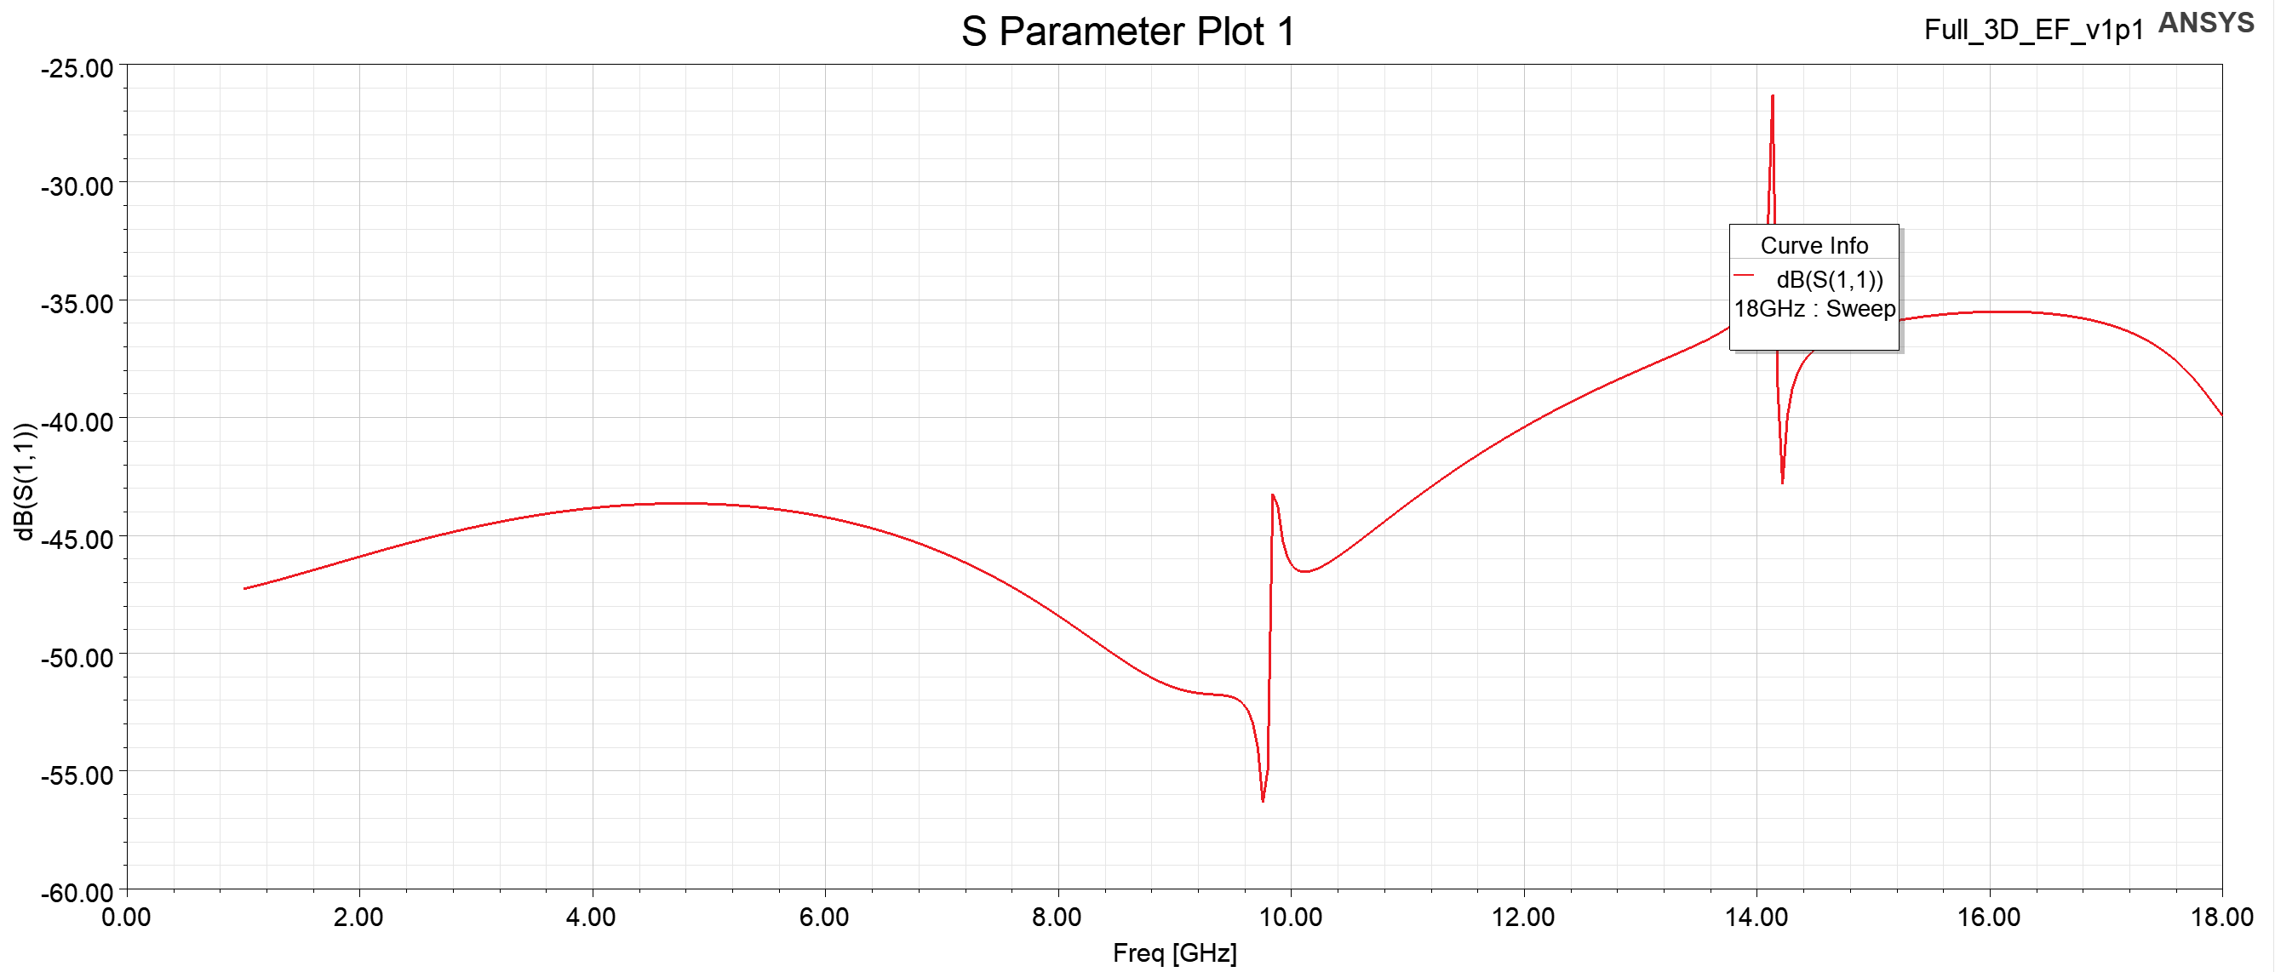
Simple model – MR-124+PCB

Slide 7
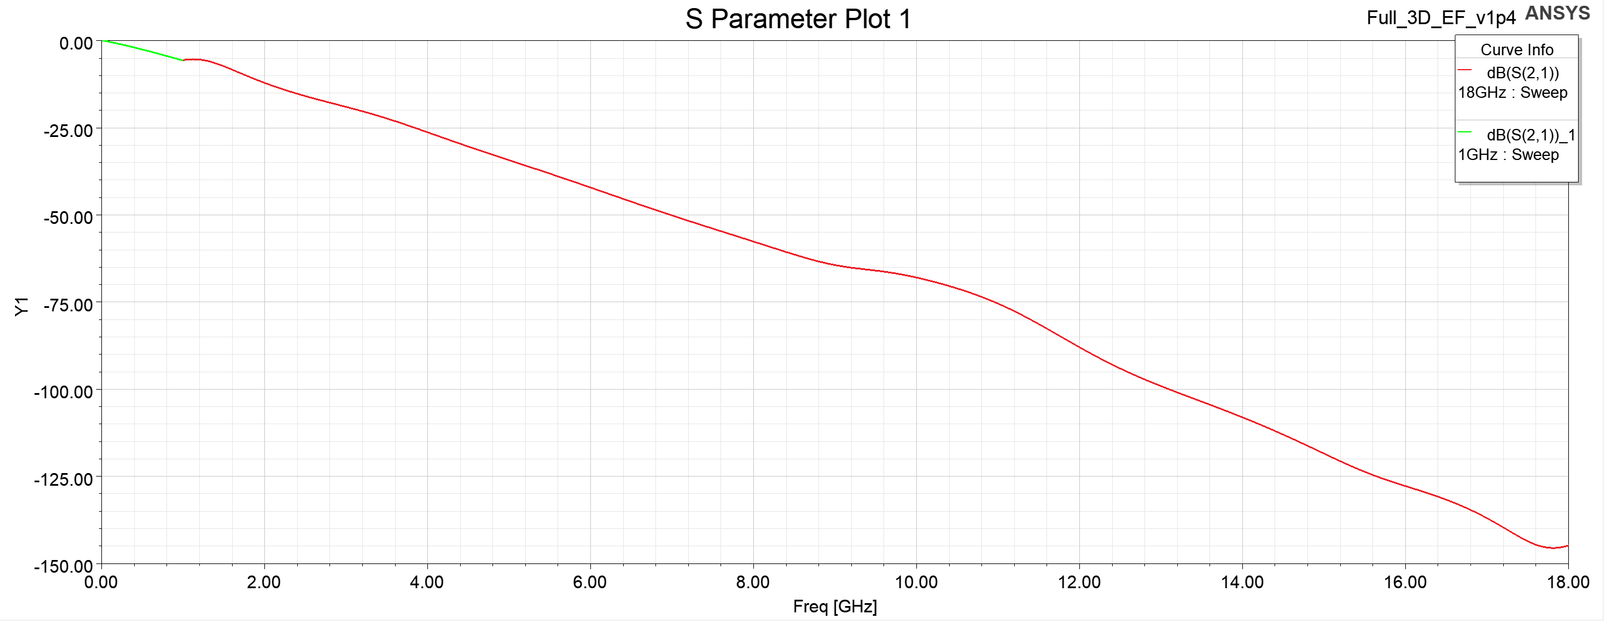
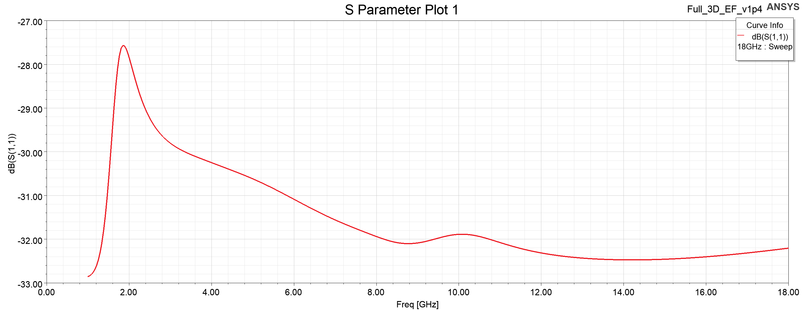
Geometry from paper

Slide 8
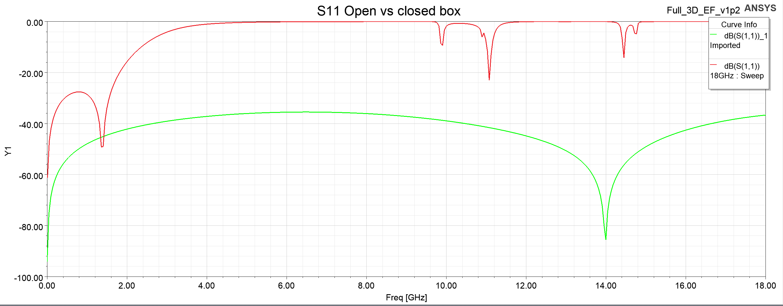
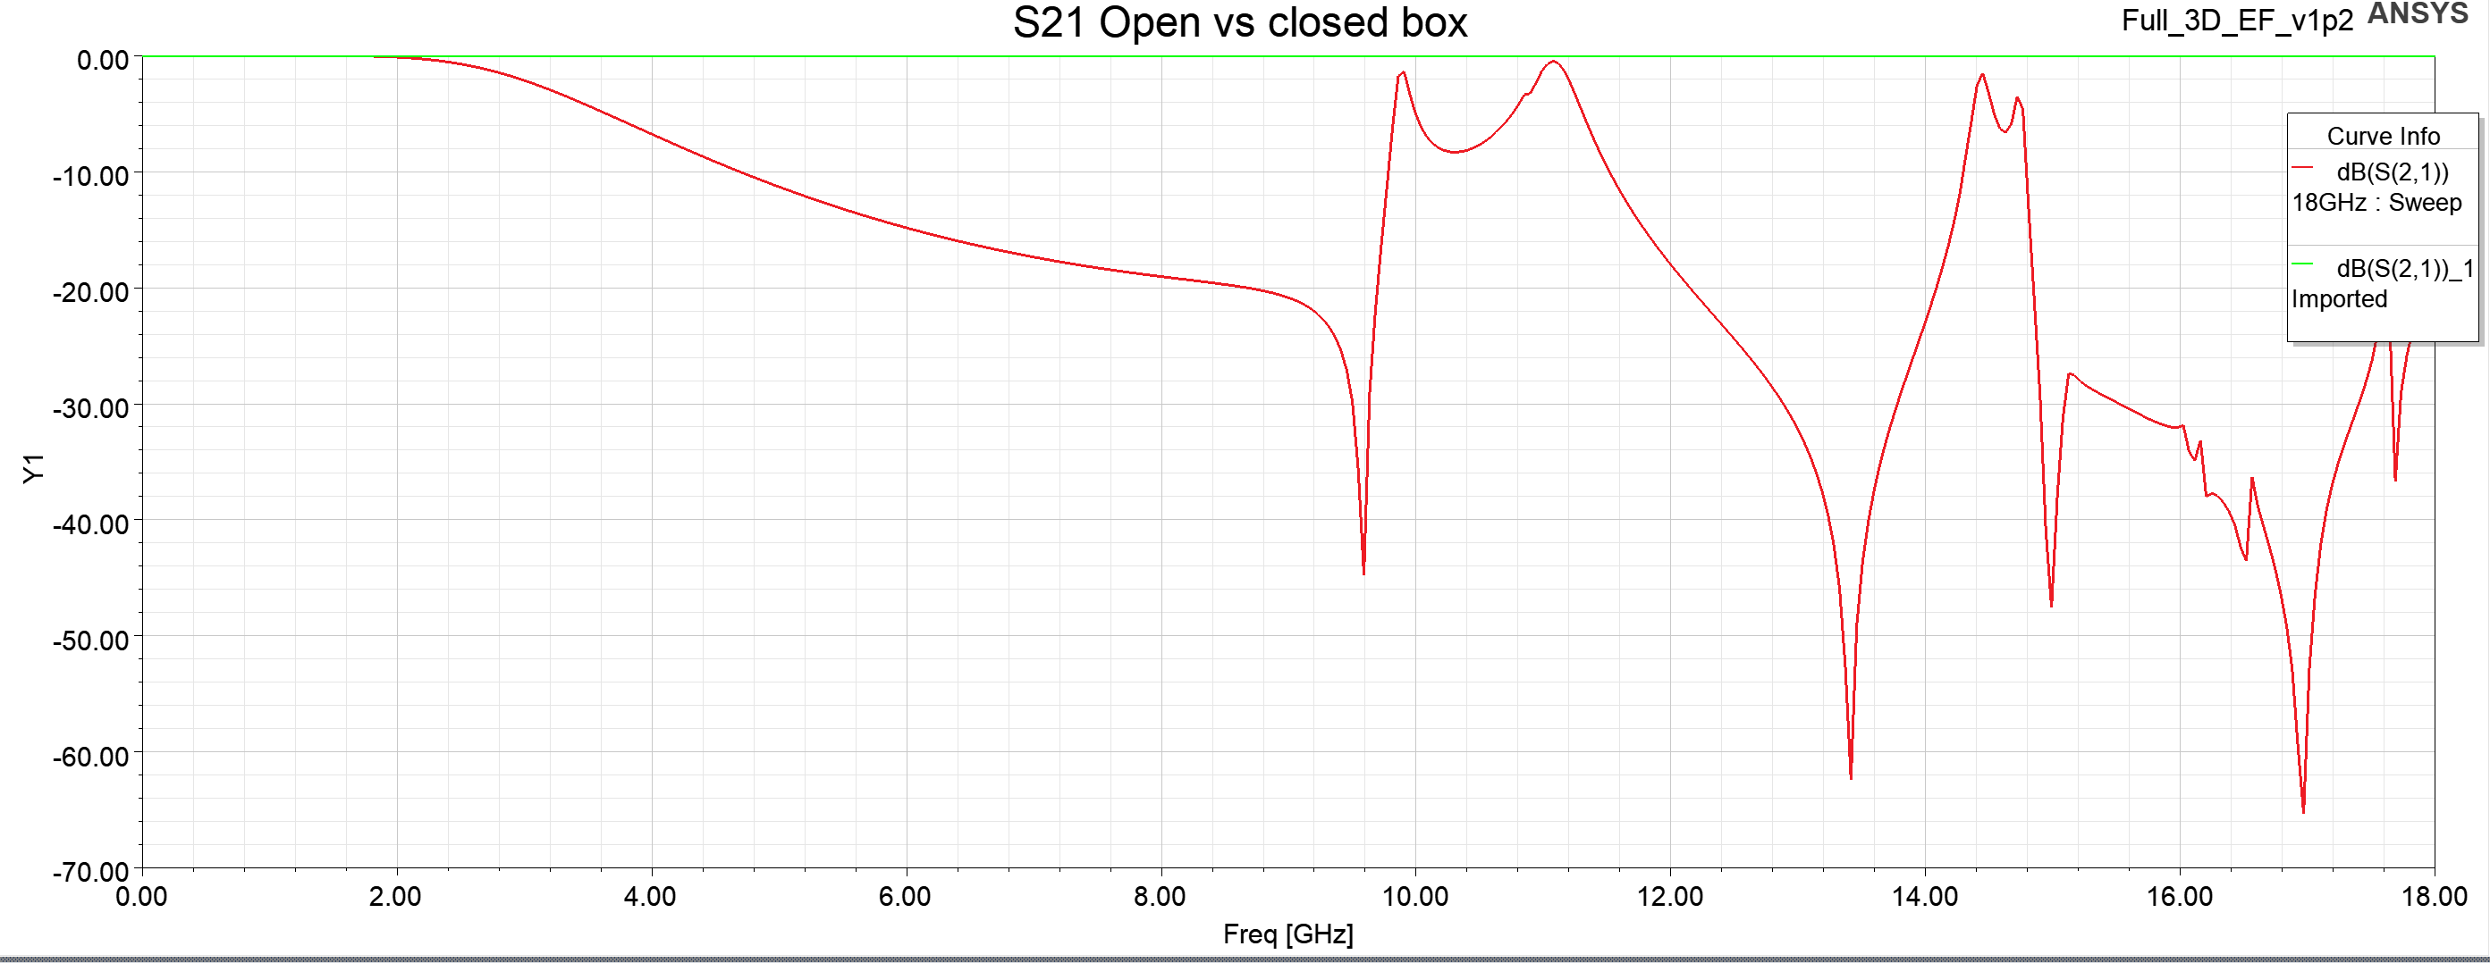
Connectorised Stripline - Teflon

Slide 9
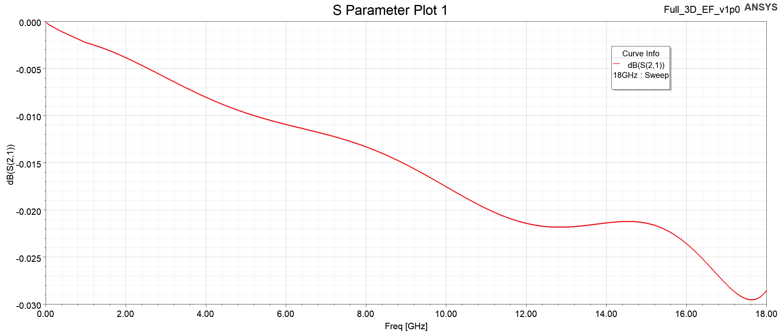
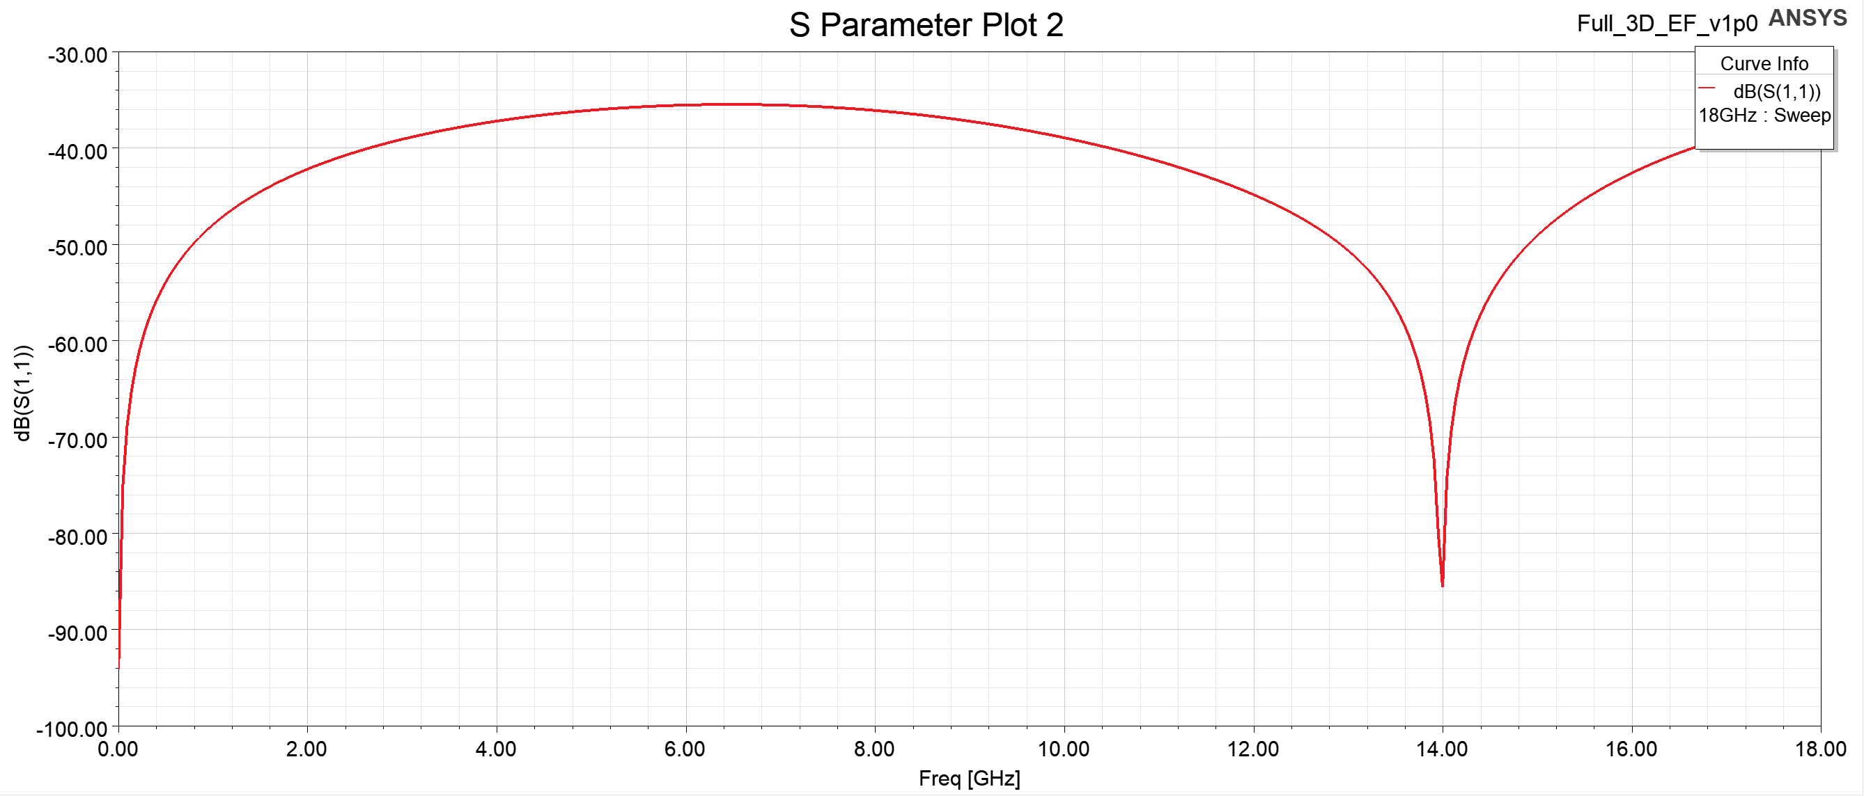
Ideal Stripline - Teflon

Slide 10
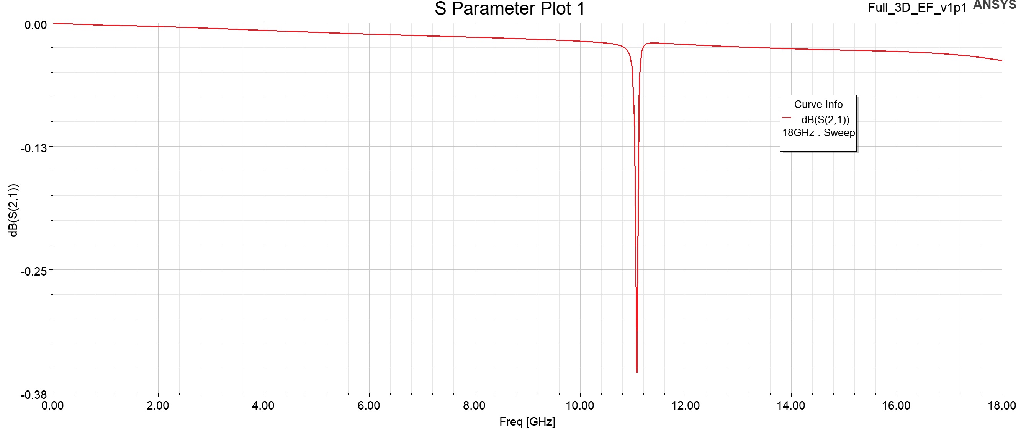
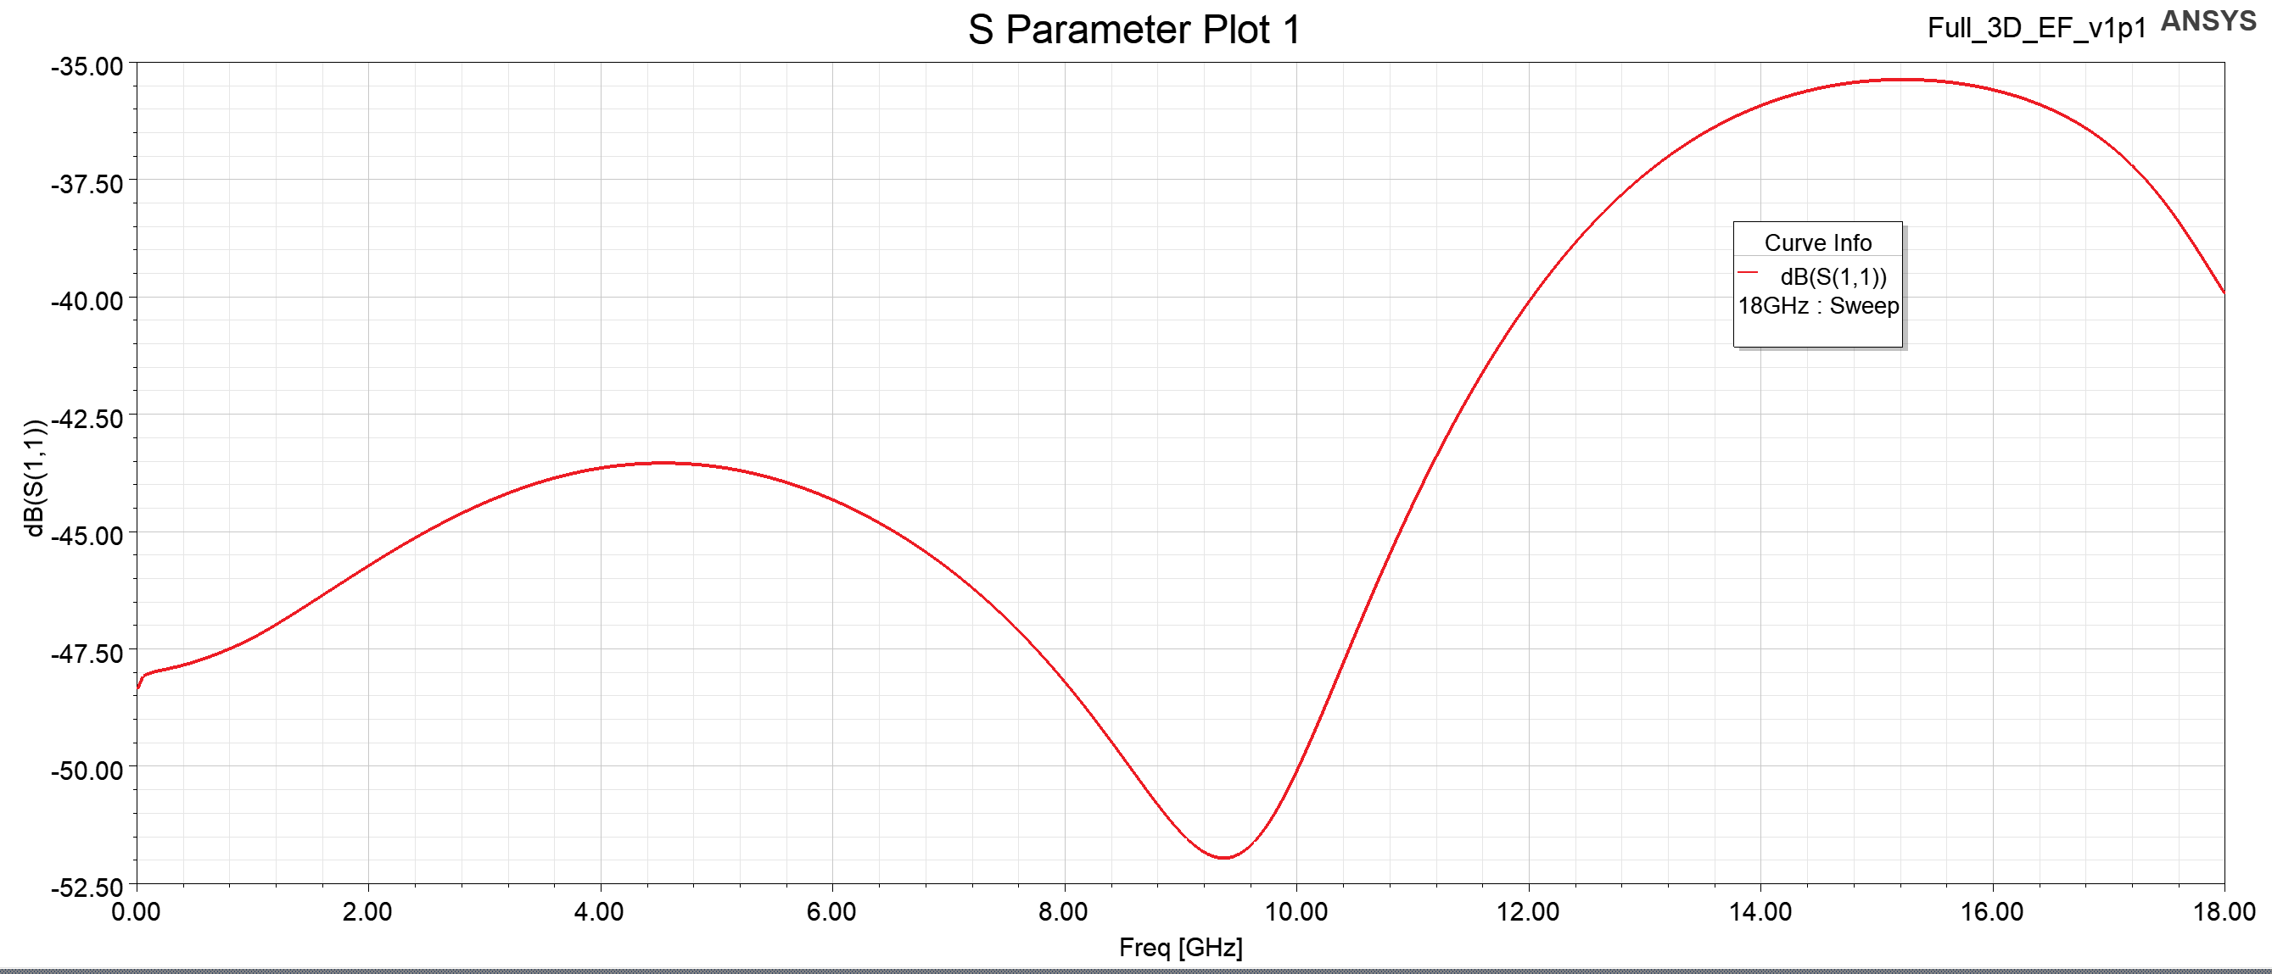
Simple model – Teflon+PCB

